Slide 1


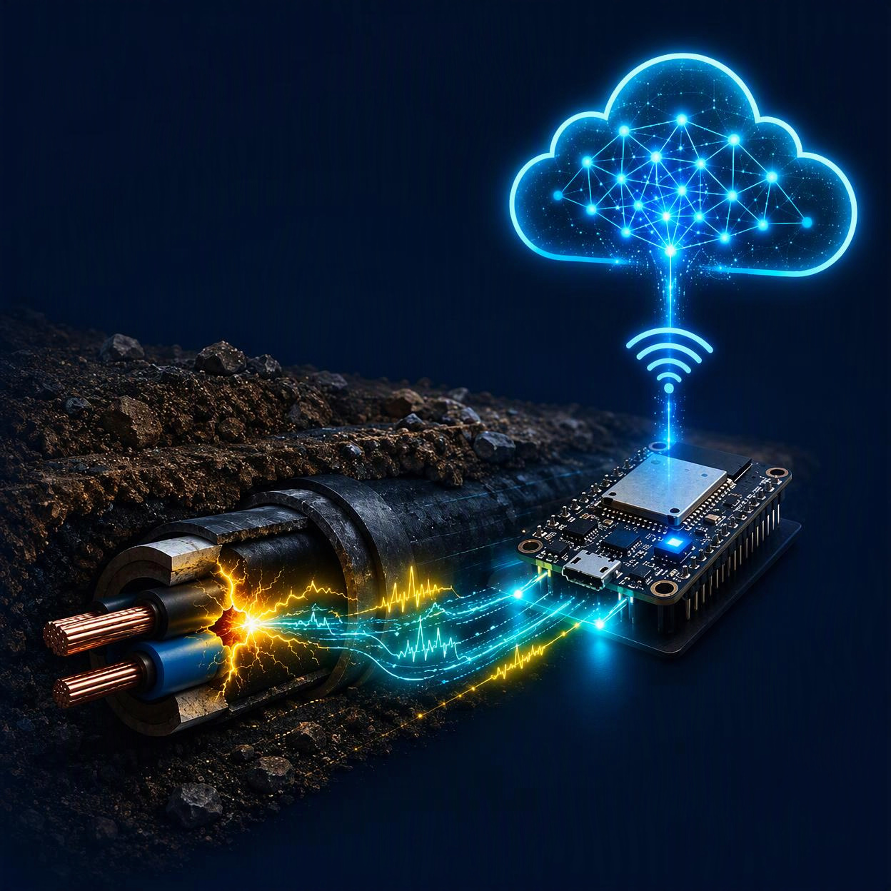
GENOVAATECH
LABS
PROJECT TITLE
AI-Enabled Underground Cable Fault Detection and Predictive Health Monitoring Using ESP32
Embedded Systems • IoT • Embedded AI • Electrical and Electronics
Predictive Maintenance Using Edge Intelligence
MONITOR · DETECT · PREDICT

Slide 2
GENOVAATECH
LABS
01
Problem Statement
CABLE SENSING / EDGE AI / CONNECTED MAINTENANCE
FAULTS · DISTANCE · SAFETY · DOWNTIME
01 HIDDEN FAULT RISK
02 INCOMPLETE VISIBILITY
03 DELAYED MAINTENANCE
Signals must be interpreted together
Voltage drop, overcurrent, near-zero current and abnormal heating can be missed when each sensor is checked in isolation.
Raw readings do not guide the repair
Teams need the likely fault class, estimated distance, alert severity and event history before deciding where to inspect.
Failures are difficult to locate
Open- and short-circuit faults interrupt supply, while underground routing makes visual inspection slow, disruptive and uncertain.
DETECT • OPEN • SHORT
CORRELATE • V • I • °C
DECIDE • LOCATE • ACT

Slide 3
GENOVAATECH
LABS
02
Abstract
CABLE SENSING / EDGE AI / CONNECTED MAINTENANCE
SENSE / ESTIMATE / CLASSIFY / CONNECT
01 INSTRUMENT THE CABLE
02 DIAGNOSE AT THE EDGE
03 CONNECT THE RESPONSE
Rules and AI produce a faster diagnosis
The device detects open/short, overcurrent, sudden-current, near-zero-current and thermal anomalies; calibrated sensing estimates distance and AI is compared with a baseline algorithm.
Every event becomes visible and traceable
A Wi-Fi dashboard shows live values, fault type, distance, status and graphs; timestamps, readings and predictions are stored while local and dashboard alerts flag abnormal trends.
Continuous electrical and thermal sensing
An ESP32 samples supply-side and load-side voltage, current and TMP117 temperature on a calibrated low-voltage cable test setup.
LIVE FEATURE STREAM
BASELINE ↔ AI
DASHBOARD • HISTORY • ALERTS

Slide 4
GENOVAATECH
LABS
03
Proposed Solution
CABLE SENSING / EDGE AI / CONNECTED MAINTENANCE
MEASURE / DIAGNOSE / RESPOND
01 SENSOR FRONT END
02 EMBEDDED DIAGNOSIS
03 CONNECTED RESPONSE
Convert features into fault intelligence
The ESP32 filters readings, applies baseline thresholds, estimates fault distance and runs an AI classifier. Agreement and disagreement between both methods are retained.
Turn diagnosis into maintenance action
Wi-Fi publishes live status and graphs; event history records timestamps and sensor context; buzzer and dashboard alerts escalate faults and unusual cable-health trends.
Capture the cable’s condition
Voltage dividers, a current-sensing circuit and TMP117 feed the ESP32. A calibrated cable fixture safely injects simulated open- and short-circuit faults.
INPUT: VIN • VOUT • I • TMP117
OUTPUT: TYPE • DISTANCE • CONFIDENCE
ACTION: ALERT • INSPECT • REPORT
SENSOR FRONT END → ESP32 EDGE DIAGNOSIS → IoT DASHBOARD + LOCAL ALERT

Slide 5
GENOVAATECH
LABS
04
Expected Output
CABLE SENSING / EDGE AI / CONNECTED MAINTENANCE
LIVE STATUS / DISTANCE / HISTORY / HEALTH
01 INSTANT DIAGNOSIS
02 MEASURED EVIDENCE
03 ACTIONABLE RECORD
Live readings explain the decision
Supply voltage, load voltage, current and TMP117 temperature appear with trend graphs. AI prediction is displayed alongside the baseline result for comparison.
Alerts and history support follow-up
Each event stores a timestamp, sensor snapshot, estimate and prediction. Local buzzer and dashboard alerts flag immediate faults; health trends identify cables that warrant inspection.
A clear fault decision
The system reports Healthy, Open Circuit, Short Circuit, Overcurrent, Near-Zero Current or Thermal Anomaly, plus an estimated distance from the cable starting point.
FAULT TYPE • DISTANCE • STATUS
VIN • VOUT • CURRENT • TEMPERATURE
TIMESTAMP • EVENT LOG • HEALTH FLAG
EXPECTED DASHBOARD FIELDS: FAULT | DISTANCE | V / I / °C | ALERT | TIMESTAMP

